Slide 1

Linear classification

Slide 2
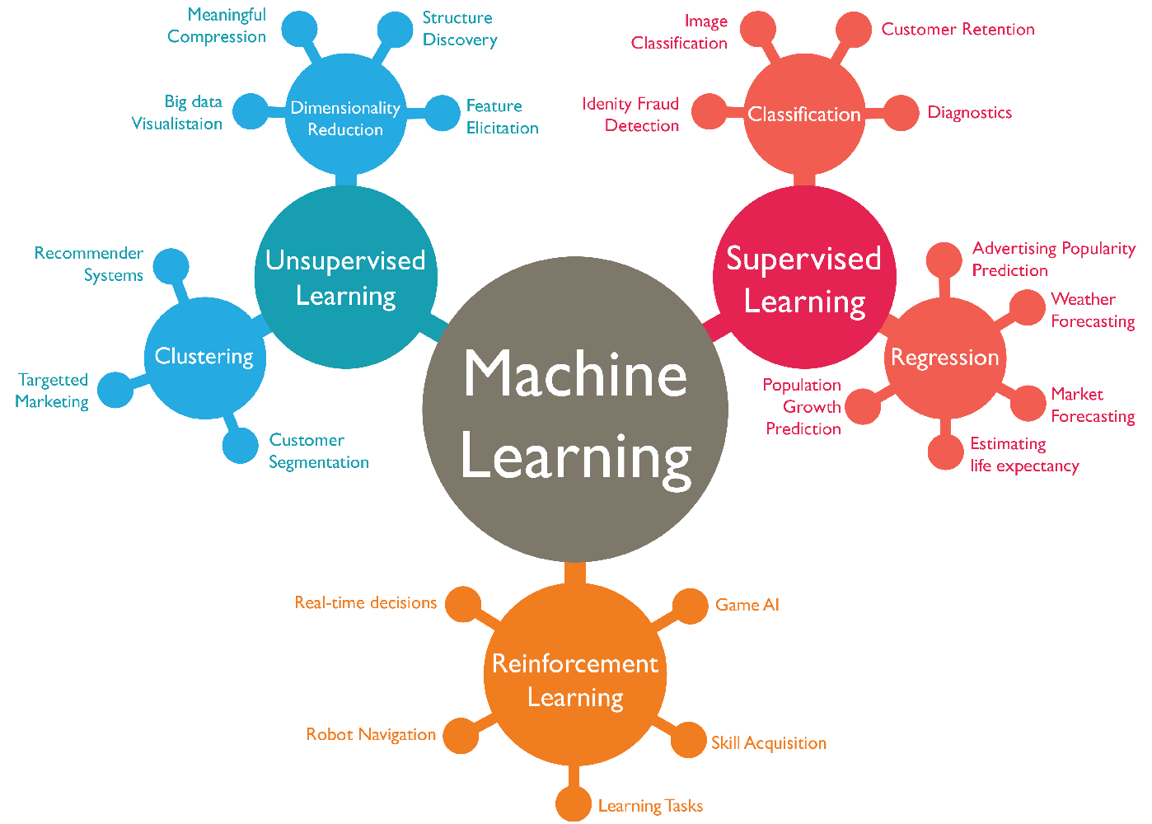
Types of learning

Slide 3
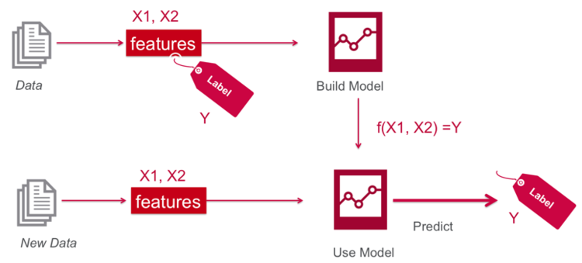
Supervised learning
Notes:
Supervised learning is the machine learning task of learning a function that maps an input to an output based on example input-output pairs. It infers a function from labeled training data consisting of a set of training examples.

Slide 4
Supervised learning
Notes:
Supervised learning is the machine learning task of learning a function that maps an input to an output based on example input-output pairs. It infers a function from labeled training data consisting of a set of training examples.

Slide 5
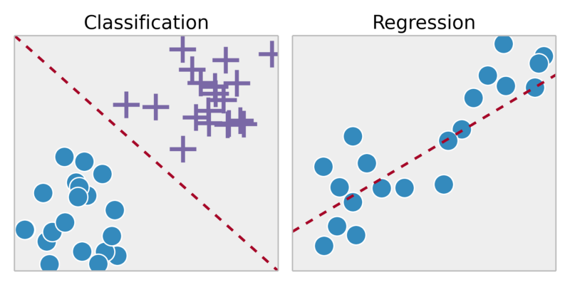
Classification vs Regression
Classification: predict a discrete (or categorical) value based on the input variables
Regression: predict a continuous value based on the input variables
Y
X₂
Y=1
Y=0
X₁
X₁
Notes:
How high can a human jump?
Classification: X1: height, X2: speed. Y: Categorical; e.g. Y1: High. Y2: Low
Regression: X1: height, Y: actual jump height (continuous)
Note: Converted regression problem into two-class (binary) classification

Slide 6
Classification vs Regression
Classification: predict a discrete (or categorical) value based on the input variables
Regression: predict a continuous value based on the input variables
Y
X₂
Y=1
Y=0
X₁
X₁
Notes:
How high can a human jump?
Classification: X1: height, X2: speed. Y: Categorical; e.g. Y1: High. Y2: Low
Regression: X1: height, Y: actual jump height (continuous)
Note: Converted regression problem into two-class (binary) classification

Slide 7
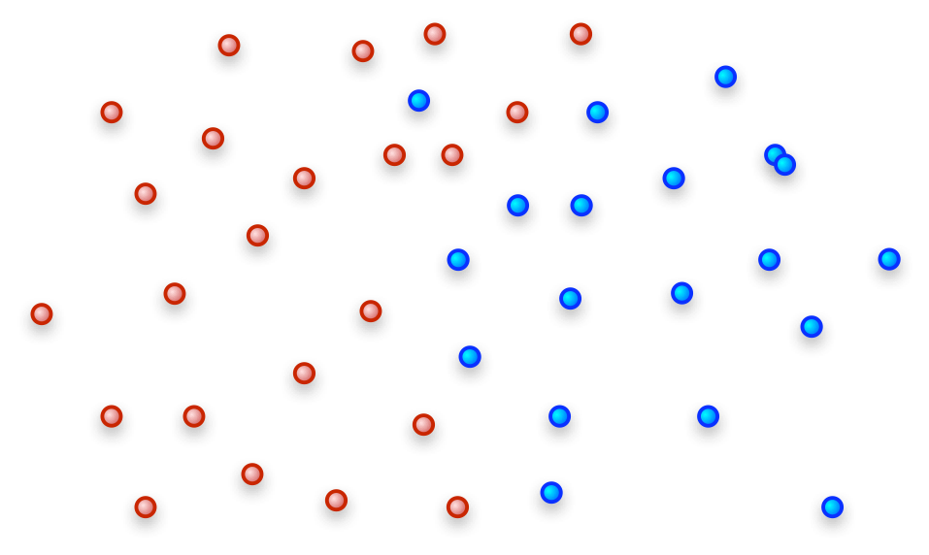
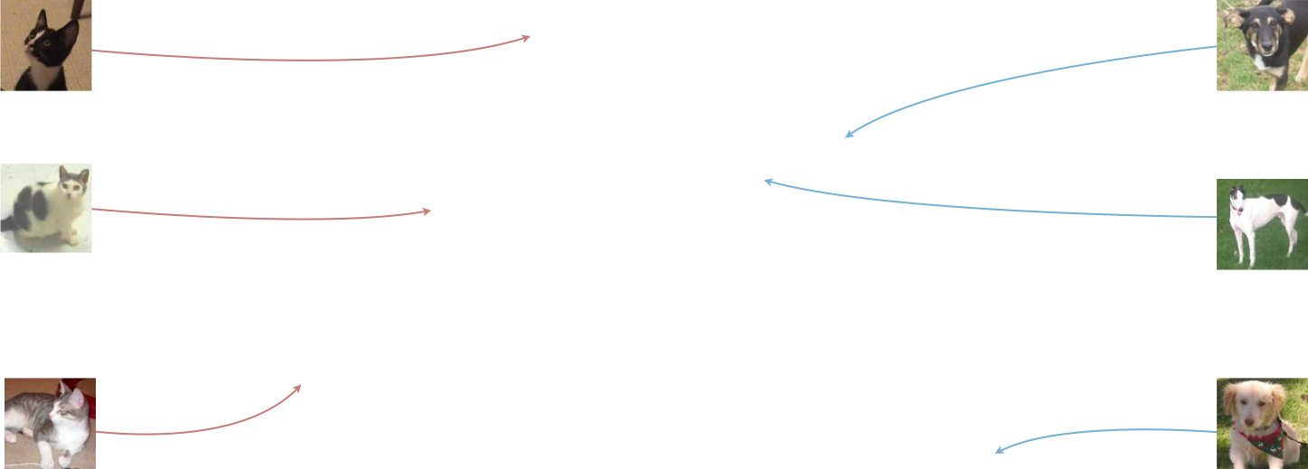


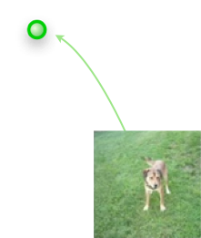
Binary classification
Notes:
Supervised learning is the machine learning task of learning a function that maps an input to an output based on example input-output pairs. It infers a function from labeled training data consisting of a set of training examples.

Slide 8
Logistic regression
Linear classification
(Focus on binary)

Slide 9
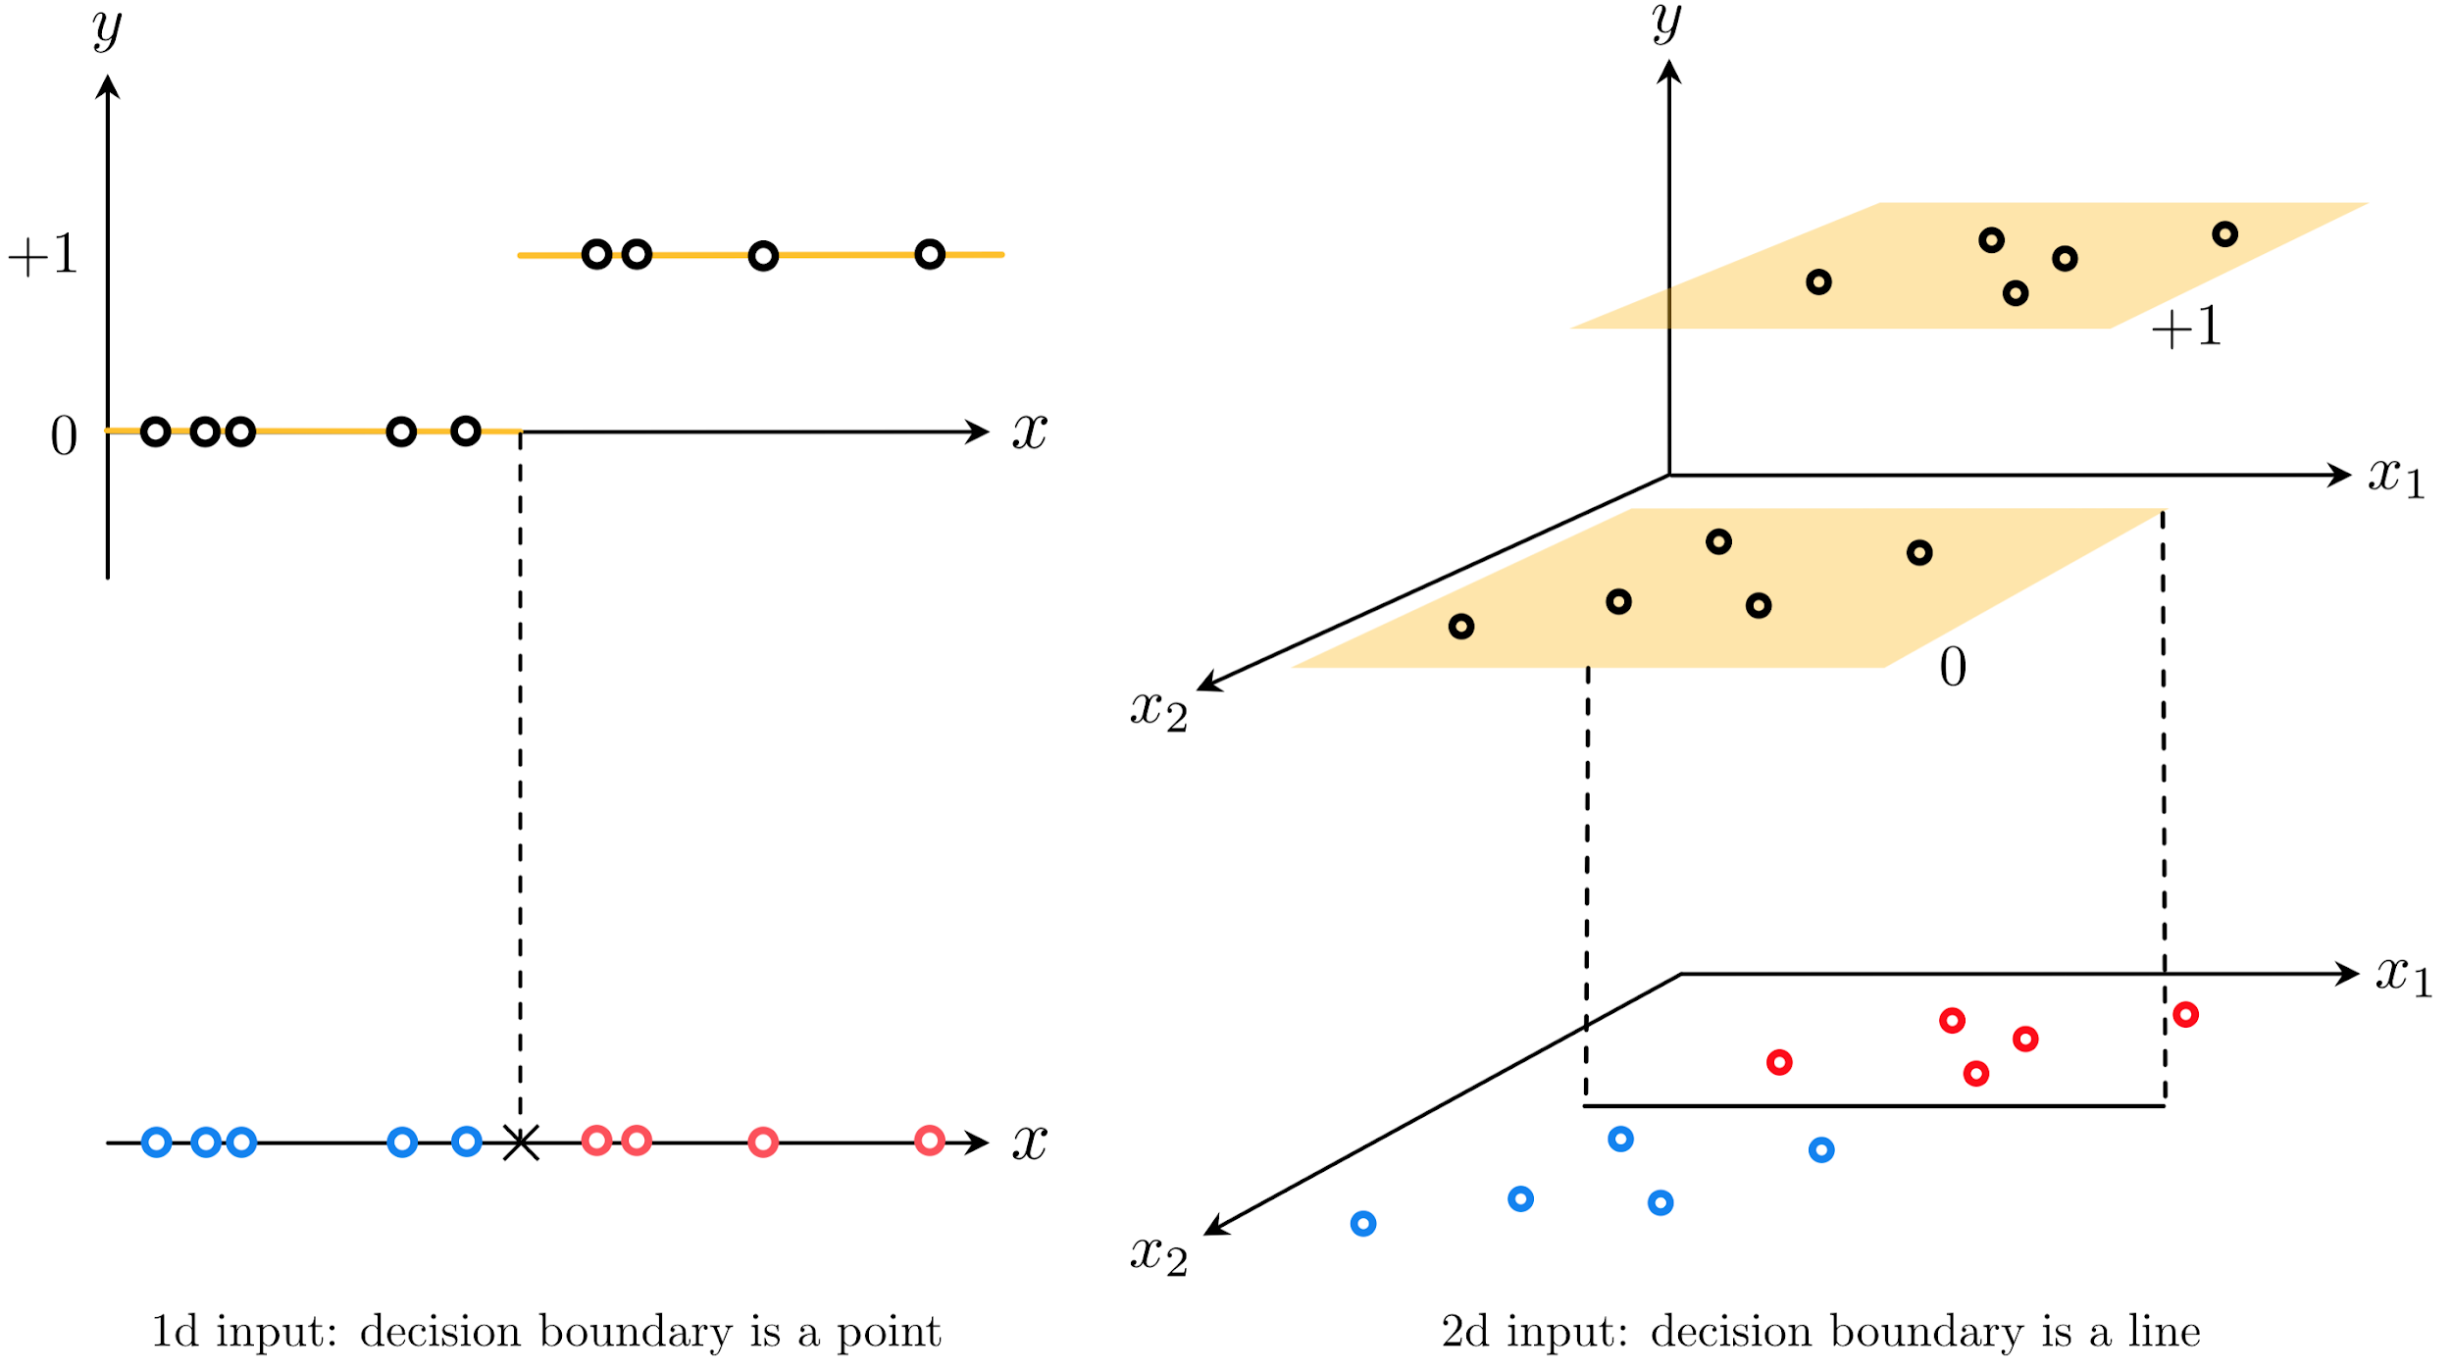
Source: J. Watt et al., “Machine Learning refined”, Cambridge University Press
Two perspectives on classification

Slide 10
Source: J. Watt et al., “Machine Learning refined”, Cambridge University Press
Two perspectives on classification

Slide 11
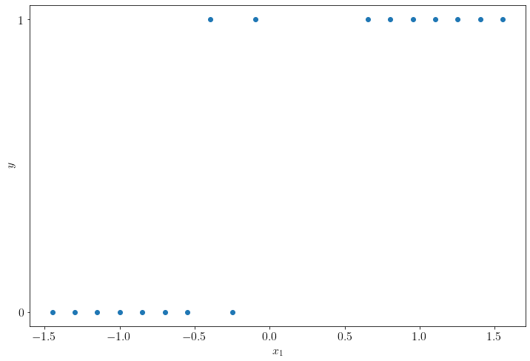
Illustrative 1D example

Slide 12
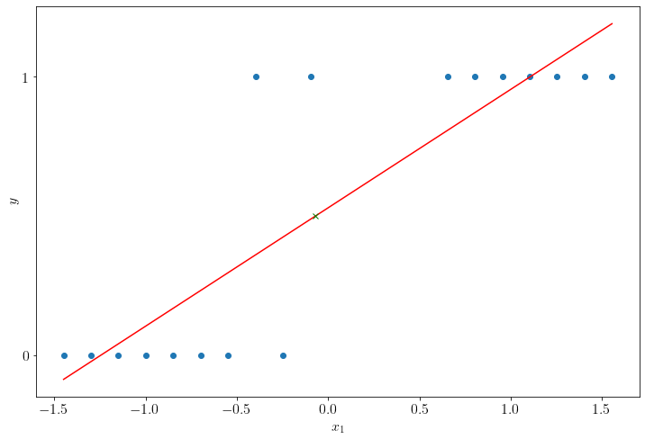
Proposition #1
How about applying the linear regression framework seen earlier to fit such data?
We minimize the following cost function:

Slide 13
Proposition #1
How about applying the linear regression framework seen earlier to fit such data?
We minimize the following cost function:

Slide 14
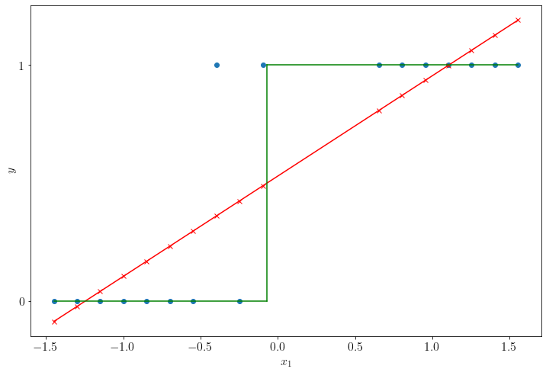
Proposition #1
And we apply a step function
0.5

Slide 15
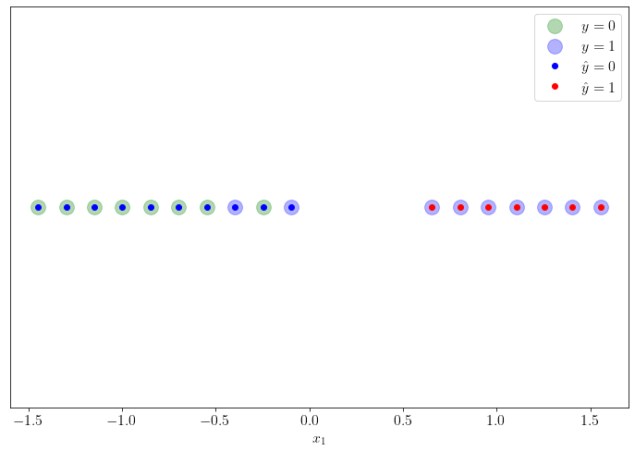
Proposition #1
Results from the other perspective: 2 classification errors. In this case, 2 false negatives.

Slide 16
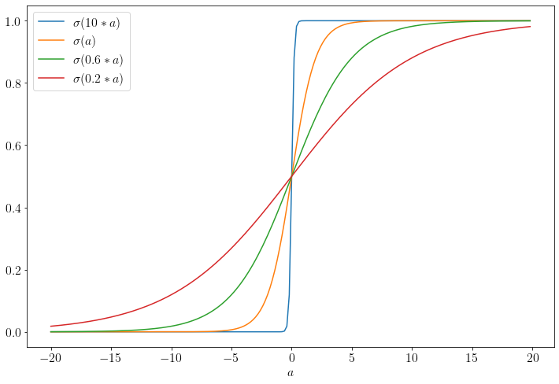
Proposition #2 – Intuition
How about integrating the step function in the cost function to minimize?
Or, better yet, a smooth approximation of the step function, the logistic sigmoïd

Slide 17
Proposition #2 – Formally
^
We’ll explicitly model the probability
The probability takes values in [0, 1]. The range of a linear model is not bounded.
We’ll extend the range to , and approximate by a linear model
Hence, , which can be written as:
^

Slide 18
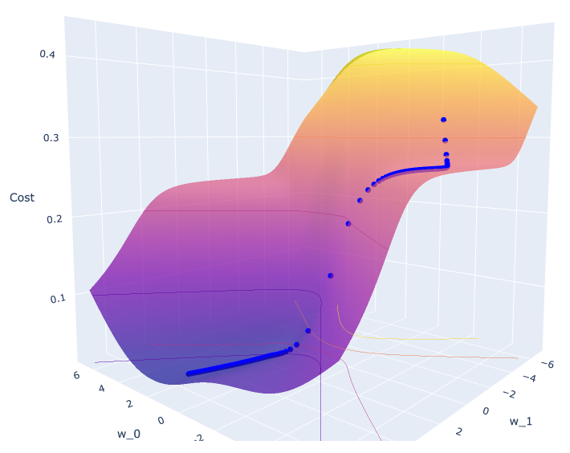
Proposition #2
So we’ll now minimize the following cost function:
There is no closed-form solution for . We’ll use gradient descent (cf. notebook).

Slide 19
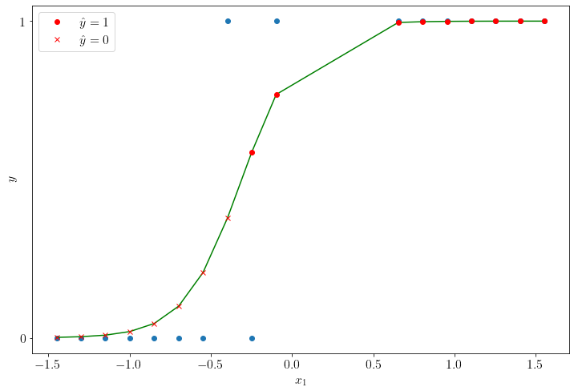
Proposition #2
So we’ll now minimize the following cost function:
There is no closed-form solution for . We’ll use gradient descent (cf. notebook).

Slide 20

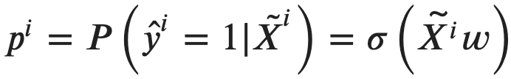
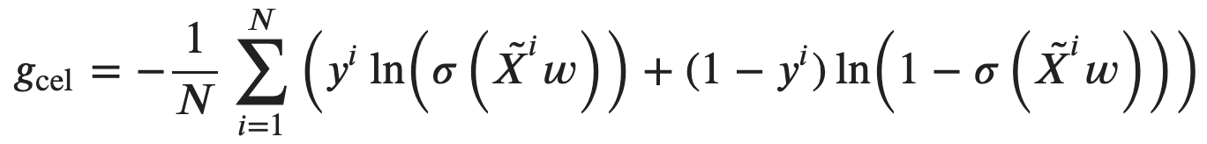
Proposition #3 – Cross entropy
A random variable follows a Bernoulli distribution if it only has two possible outcomes: 0 or 1.
The likelihood of a Bernouilli distribution over N observations:
which we wish to maximize.
Recall that
We want to minimize the negative log-likelihood:

Slide 21
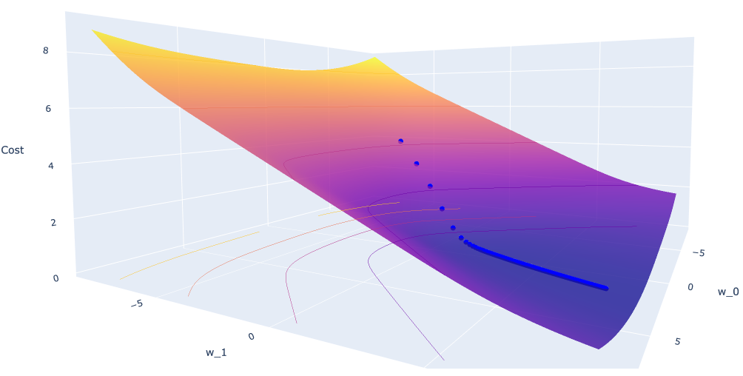
Proposition #3
We want to minimize the negative of the log-likelihood (or cross entropy):
There is no closed-form solution for . We’ll use gradient descent (cf. notebook).

Slide 22
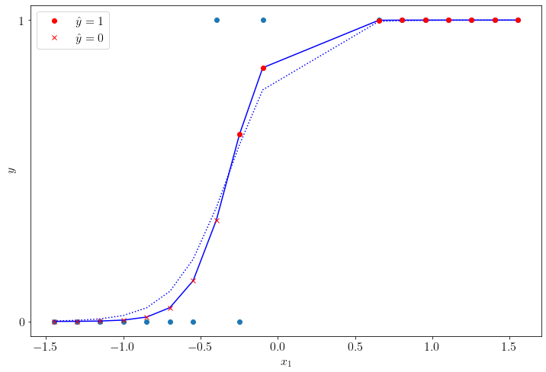
Minimizing the Cross Entropy

Slide 23
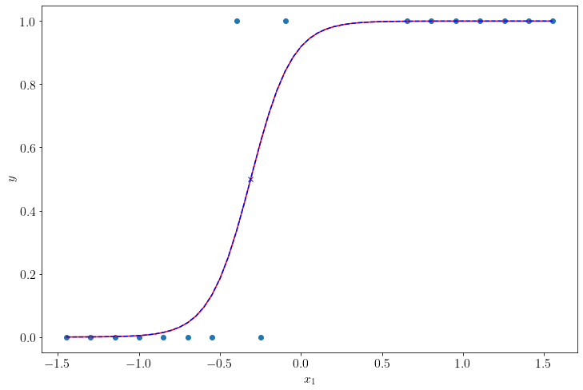
Now using scikit-learn
# Régularisation: 'none' ou 'l2'
clf = sklearn.linear_model.LogisticRegression(solver='lbfgs',penalty='none')
clf.fit(X, y.reshape(N,))
w_0, w_1 = clf.intercept_[0], clf.coef_[0][0]

Slide 24
Performance evaluation
Classification

Slide 25
Confusion matrix and statistics
Sensitivity: True Positive Rate or Recall
(1 – Specificity): False Positive Rate
Source: Data Science and machine learning: The confusion matrix

Slide 26
Exercise
Calculate precision, sensitivity and specificity
Calculate accuracy and F1 score
Source: Data Science and machine learning: The confusion matrix

Slide 27
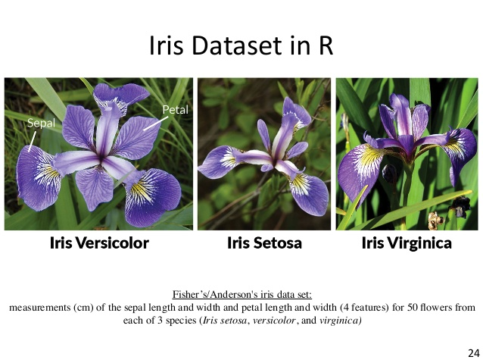

Real example using scikit-learn
UCI Machine Learning Repository

Slide 28
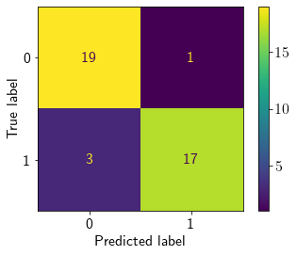
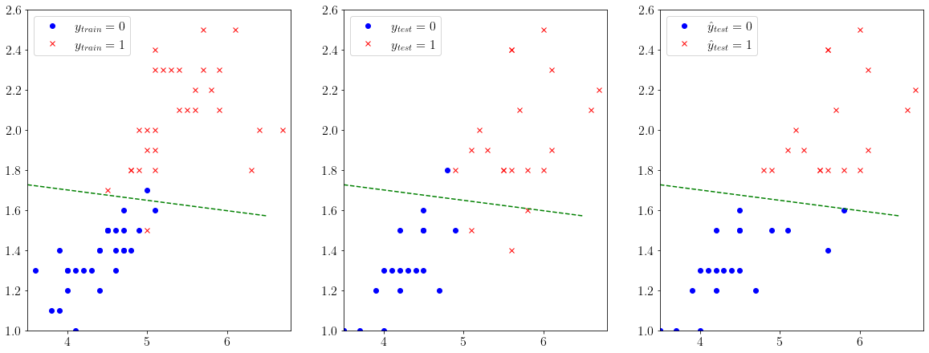
Iris dataset {versicolor: 0, virginica: 1}
Confusion matrix
Using train-test-split, 30% test
Using logistic regression (no regularization)

Slide 29
What did I learn?
Definition of (binary) classification (vs regression)
Logistic regression using various cost functions
In particular, the cross entropy cost (or negative log-likelihood)
Confusion matrix for classification performance

Slide 30

QUESTIONS ?

